Slide 1
Physical Features of Earth Unit 2, Lesson 4

Slide 2
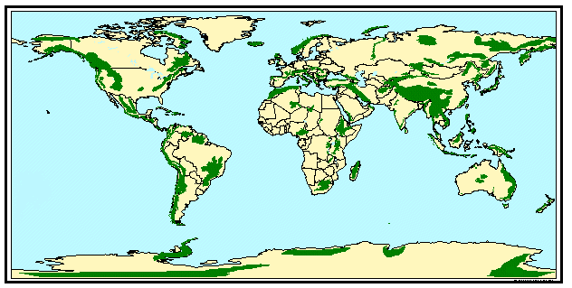
What map projection do you think this is?
How do you know?
While this map does have some similarities to both the Mercator and Robinson projections, it is still another type of projection you haven’t learned about yet.
This is called an equirectangular projection.
Map 1
Notes:
Mountains of the World. 25 July 2012. http://www.staff.amu.edu.pl/~zbzw/glob/glob20aa.htm

Slide 3
Respond in writing:
What physical feature do you think is being shown on map 1?
What evidence do you have for thinking so?
Map 1
Notes:
Mountains of the World. 25 July 2012. http://www.staff.amu.edu.pl/~zbzw/glob/glob20aa.htm

Slide 4
Mountains of the World
How many guessed that right?
Let’s share your supporting evidence.
Map 1
Notes:
Mountains of the World. 25 July 2012. http://www.staff.amu.edu.pl/~zbzw/glob/glob20aa.htm

Slide 5
Can you identify any spatial patterns you see?
(In other words, how would you describe
where the mountains are on Earth?)
Turn and talk at your table about your description of the location
of mountains on Earth.

Slide 6
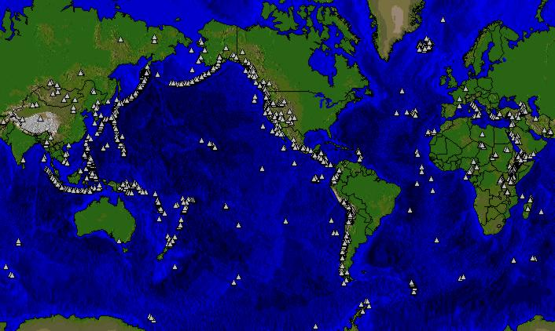
Describe what you see on this map.
Map 2
Notes:
Volcanoes of the World. 25 July 2012. http://www.staff.amu.edu.pl/~zbzw/glob/glob28d2.htm

Slide 7
Compare this map to the previous map.
How is the new map different from the previous map?
Did you notice
the centers of the
maps differ?

Slide 8
Respond in writing:
What physical feature do you think is being shown on map 2?
What evidence do you have for thinking so?
Map 2
Notes:
Volcanoes of the World. 25 July 2012. http://www.staff.amu.edu.pl/~zbzw/glob/glob28d2.htm

Slide 9
Volcanoes of the World
How many guessed that right?
Let’s share your supporting evidence.
Map 2
Notes:
Volcanoes of the World. 25 July 2012. http://www.staff.amu.edu.pl/~zbzw/glob/glob28d2.htm

Slide 10
Can you identify any spatial patterns you see?
(In other words, how would you describe
where the volcanoes are on Earth?)
Turn and talk at your table about your description of the location
of volcanoes on Earth.

Slide 11
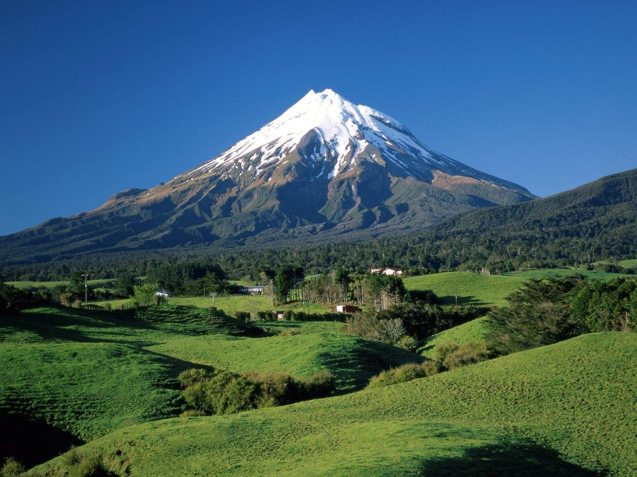
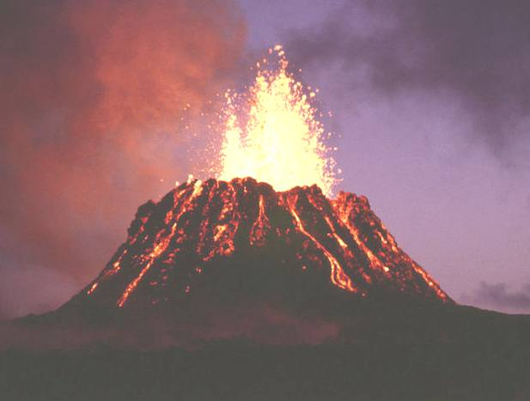
Why are the spatial patterns of these two physical
features so similar?
Are there connections between mountains and volcanoes?
Are mountains and volcanoes always found together? Why do you think this is so?
Can there be a mountain without a volcano? Can there be a volcano without a mountain?

Slide 12
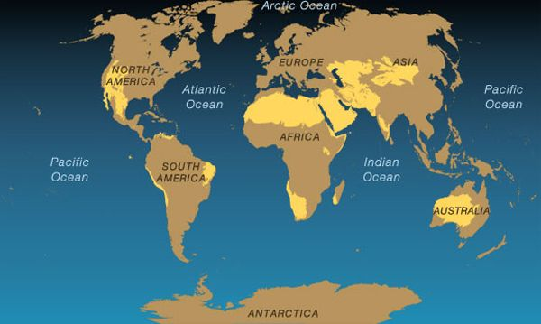
Respond in writing:
What physical feature do you think is being shown on this map?
What evidence do you have for thinking so?
Map 3
Notes:
Deserts of the World. 6 August 2012. http://environment.nationalgeographic.com/environment/habitats/desert-map/

Slide 13
Deserts of the World
How many guessed that right?
Let’s share your supporting evidence.
Map 3
Notes:
Deserts of the World. 6 August 2012. http://environment.nationalgeographic.com/environment/habitats/desert-map/

Slide 14
Can you identify any spatial patterns you see?
(In other words, how would you describe
where the deserts are on Earth?)
Turn and talk at your table about your description of the location
of deserts on Earth.

Slide 15
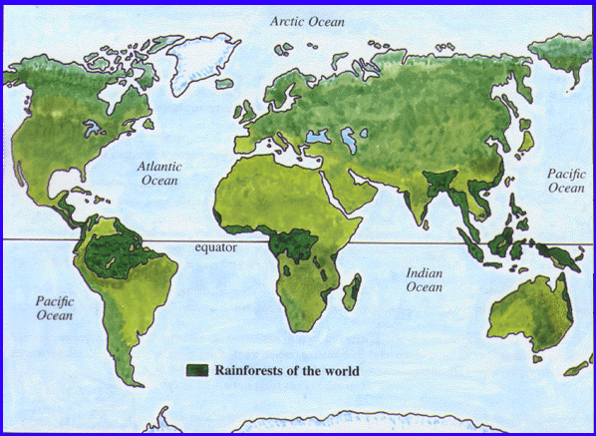
Respond in writing:
What physical feature do you think is being shown on map 4?
What evidence do you have for thinking so?
Map 4
Notes:
Rainforests of the World. 7 August 2012. http://www.srl.caltech.edu/personnel/krubal/rainforest/Edit560s6/www/where.html

Slide 16
Rainforests of the World
How many guessed that right?
Let’s share your supporting evidence.
Map 4
Notes:
Rainforests of the World. 7 August 2012. http://www.srl.caltech.edu/personnel/krubal/rainforest/Edit560s6/www/where.html

Slide 17
Can you identify any spatial patterns you see?
(In other words, how would you describe
where the rainforests are on Earth?)
Turn and talk at your table about your description
of the location of rainforests on Earth.

Slide 18
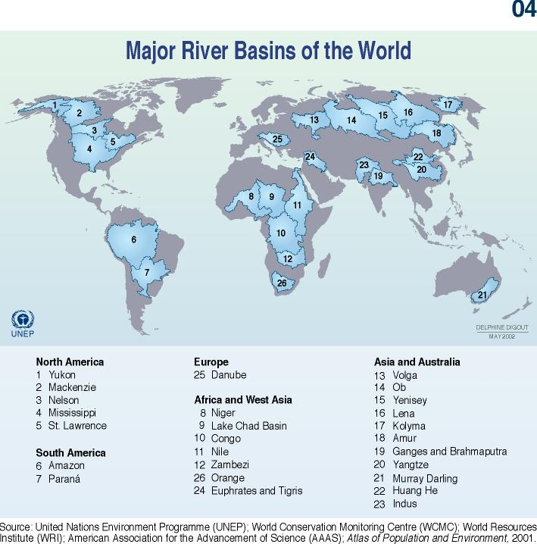
Respond in writing:
What physical feature do you think is being shown on map 5?
What evidence do you have for thinking so?
Map 5
Notes:
Major River Basins of the World. 7 August 2012. http://www.siswebs.org/water/story.php?title=Major_river_basins_of_the_world

Slide 19
Major River Basins of the World
How many guessed that right?
Let’s share your supporting evidence.
Map 5
Notes:
Major River Basins of the World. 7 August 2012. http://www.siswebs.org/water/story.php?title=Major_river_basins_of_the_world

Slide 20
Can you identify any spatial patterns you see?
(In other words, how would you describe
where the river basins are on Earth?)
Turn and talk at your table about your description of the location
of river basins on Earth.

Slide 21
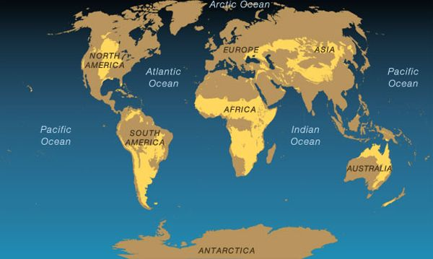
Respond in writing:
What physical feature do you think is being shown on map 6?
What evidence do you have for thinking so?
Map 6
Notes:
Grasslands of the World. 6 August 2012. http://environment.nationalgeographic.com/environment/habitats/grassland-map/

Slide 22
Grasslands of the World
How many guessed that right?
Let’s share your supporting evidence.
Map 6
Notes:
Grasslands of the World. 6 August 2012. http://environment.nationalgeographic.com/environment/habitats/grassland-map/

Slide 23
Can you identify any spatial patterns you see?
(In other words, how would you describe
where the grasslands are on Earth?)
Turn and talk at your table about your description of the location
of grasslands on Earth.

Slide 24
Is there a connection between some physical features and their location to the equator? Why or why not?
Mountains
Volcanoes
Deserts
River
Basins
Grasslands

Slide 25
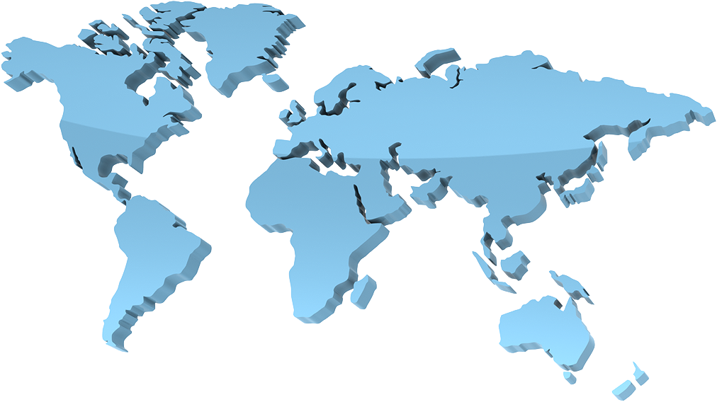
Respond in your notes:
Considering all the earth’s physical features, which ones seem to be connected?
What physical features are not connected to each other?
Mountains
Deserts
Rainforests
Rivers and River Systems
Oceans
and
Seas
Significant Physical Features of Earth
Lakes
Glaciers
Islands
Volcanoes
Grasslands

